Slide 1


Reading at
Chellaston Infant school
Notes:
Welcome to our meeting about reading at Chellaston Infant School

Slide 2

Reading is not merely the acquisition of words on a page; it is the gateway to a world of knowledge, imagination, and cognitive growth.
Reading stimulates the brain, fostering critical thinking skills, problem-solving abilities, and creativity. It is an active mental process that engages multiple regions of the brain and contributes to overall cognitive development.
Reading proficiency is a key predictor of academic success across all subjects. Students who excel in reading are better equipped to understand complex concepts in mathematics, science, and other disciplines.
Through literature, children encounter characters from diverse backgrounds and experiences. This exposure cultivates empathy and a deeper understanding of the world, contributing to the development of socially aware and compassionate individuals.
Notes:
Here are a few quotes about the importance of both reading and being read to. This is the most important skill that children will develop during their primary school education.

Slide 3

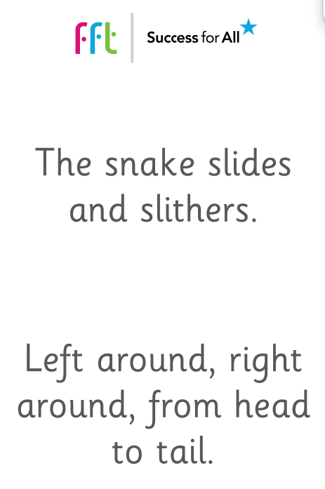





Phonics
s – a - t
Notes:
The teaching of phonics enables children to begin to read through learning sounds and then blending these together to form words. This year we have moved on to teach phonics through FFT phonics. We teach the sounds alongside a rhyme to help the children to remember them. The children first learn to blend them orally before needing to recognize the written sound which they then blend to read.

Slide 4
Vocabulary and terminology
Phoneme – The individual units of sound that make up a word.
c a t
● ● ●

Slide 5
Grapheme – What we write to represent a sound – this could be more than one letter
ai ay a_e
s n ai l s ay s afe
● ● ─ ● ● ─ ● ─

Slide 6
Digraph – The single sound that two letters
together make
ch sh ir ee
ch air sh i p g ir l b ee p
─ ─ ─ ● ● ● ─ ● ● ─ ●

Slide 7
Trigraph – The single sound that three letters
together make
igh ear air
s igh t f ear ch air
● ─ ● ● ─ ─ ─

Slide 8

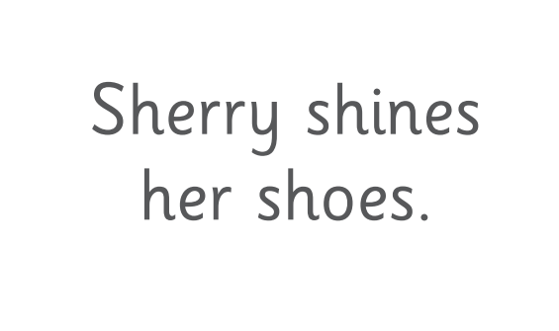
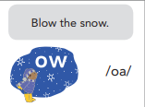


Phonics
Notes:
As the children move up through the school they begin to learn digraphs (two letters together which make one sound) before learning alternative pronunciations for sounds.

Slide 9
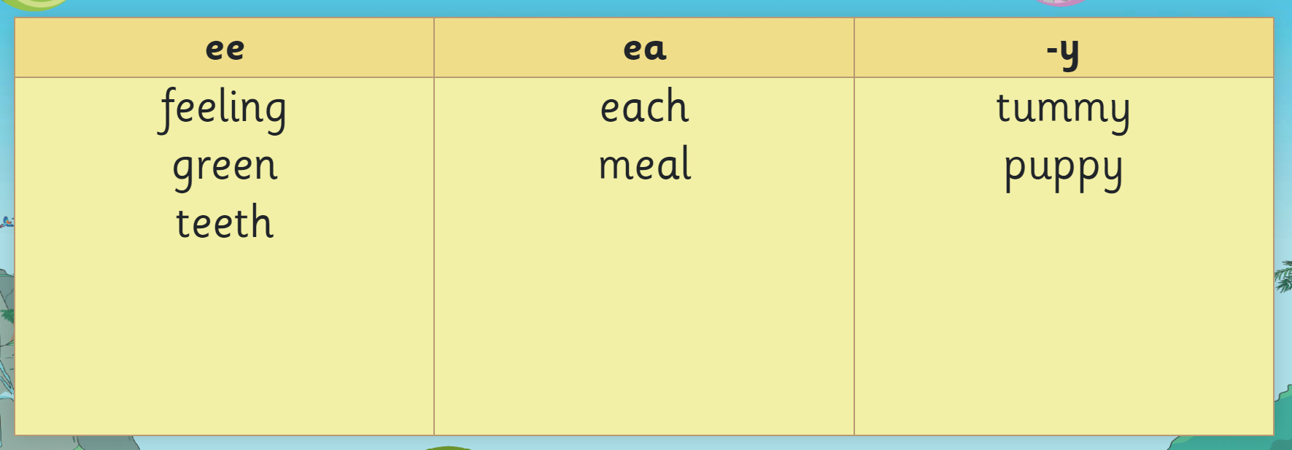
Phonics - Spelling
Notes:
In Year 2 the children focus on what they have been taught and look at how this applies within different words both for reading and spelling. The above is an example of how the different ee sounds are written in each of the above words.

Slide 10






Phonics –
Red words
Notes:
These are example of red words which cannot be sounded out and blended and the children practice sight reading these in phonics lessons.

Slide 11
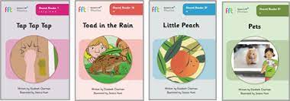
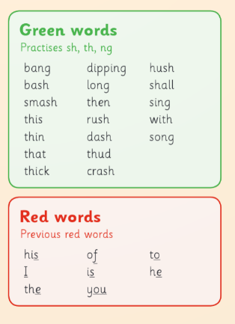
Building on phonics in shared reading
The children begin from Reception through to Year 2 having
daily shared reading lessons.
These link to phonics and begin with the teacher supporting
the sounding and out and blending of ‘green words’ and
then the sight reading of ‘red words.’
Notes:
The children continue to work on word reading in shared reading which builds on what they have been learning in phonics.

Slide 12
Building fluency
Choral reading
Fluency is defined by the EEF as reading with 'accuracy, automaticity and prosody', the Shared Reader lessons develop all three of these aspects. The Reading Framework (July 2021) was clear on how repeated reads support with children's fluency to enable them to use their cognitive resources on comprehension rather than decoding. In line with this, we ensure children have opportunities to re-read the text across the week within the Shared Reader lessons. In the majority of the programme, children will read the whole book three times during the week.
Notes:
Along with practicing the actual reading of a text shared reading allows the children to build their fluency.
The teacher will lead the reading of each word before returning to the start of the sentence and re-reading the words without needing to sound out each word out enabling the children to gain more accuracy and automaticity.

Slide 13
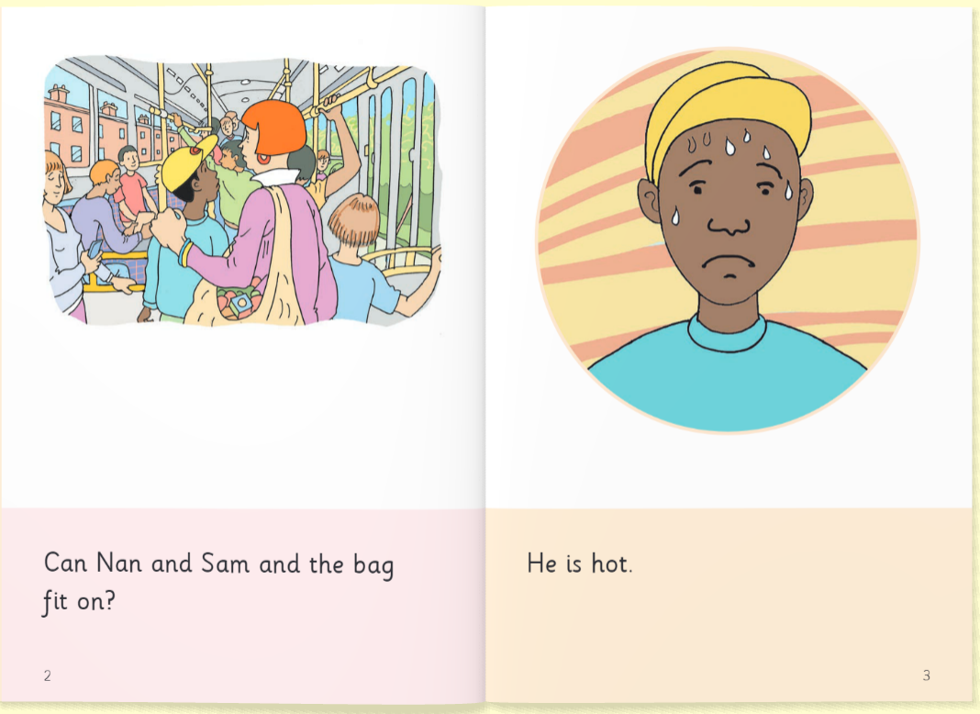
Building fluency
Choral reading
Notes:
Demonstrate choral reading

Slide 14
Building fluency
Echo reading
Echo reading builds on choral reading but has a ‘my turn, your turn element’ so the children can model a particular skill.
This will usually be something the teacher has identified as a skill which needs to be worked on.
This could be responding to punctuation or adding expression to the story.

Slide 15
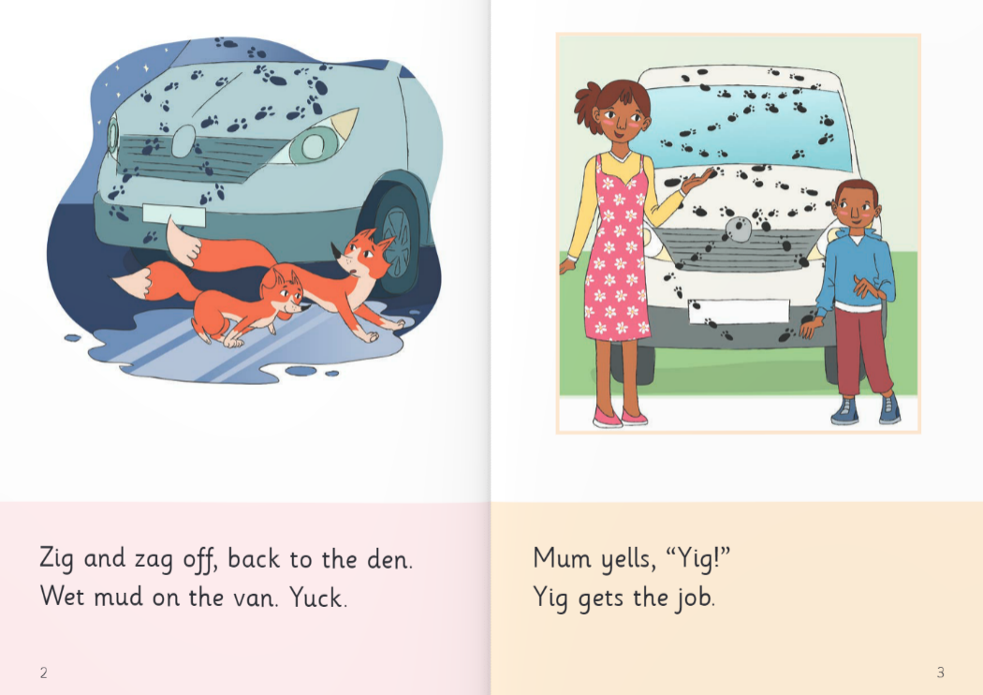
Echo reading
Building fluency

Slide 16
The benefits
Shared reading allows children to work with a partner to read through a given text:
For the more confident reader this allows them to develop a ‘mastery approach’ to reading.
They can develop further fluency and automaticity and develop the skill of being able to teach and support others in what they know.
For less confident readers they can feel more confident to ‘have a go’ after the pre-teaching of words and the repeated re-reading of words.
Shared discussion builds the vocabulary and comprehension with all children accessing the same text.
Working together gives the children more confidence and allows the teacher to model pronunciation, expression and fluent reading.

Slide 17
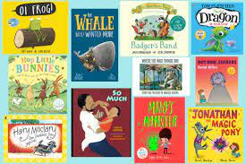
Reading at home
Reading exposes children to a rich and varied vocabulary, helping them develop language skills. It introduces new words, sentence structures, and ideas, contributing to enhanced communication skills.
Reading helps children develop the ability to concentrate and focus for extended periods. As they engage with a story, they learn to follow a narrative, track characters and events, and understand cause and effect.

Slide 18
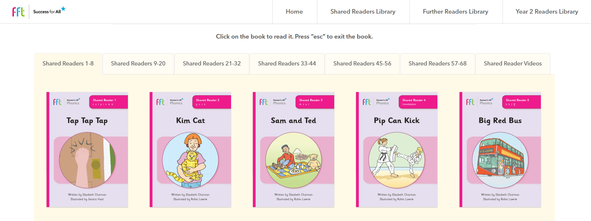
Reading at home
Link to shared reading texts.
Notes:
Accessing the text that your child has read in school will give you an opportunity to further support them in fluency and automaticity. The link will be sent out on dojo after the book has been read which will be weekly in FS and Year 1 and fortnightly in Year 2 as this is often a longer text.

Slide 19
Reading at home
Choral reading and echo reading
Notes:
Choral reading – reading the sentence again with your child after they have sounded it out to gain fluency is something that you could work on at home. As is echo reading where you could ask your child to copy you if you feel like they are struggling on a particular part of the text or with adding expression.

Slide 20
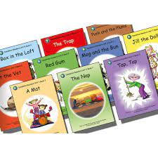
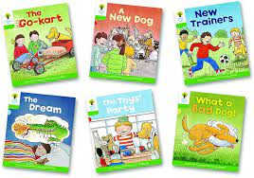
Reading at home
Your child’s reading book
All children will be bringing home two books a week. Whilst working on their phonics skills the books will be phonetically
decodable and reflect what the children have learnt so far in phonics.
When the children have gained more confidence, they will bring home a non-decodable text which contain more sight words
and words with alternative pronunciations.
Different books allow the children to access a wider variety of texts including non-fiction and work on their
comprehension skills as well as their decoding.
Reading each book twice will support the children in decoding and recognising words in their initial read and
then re-reading with more understanding and fluency.
Notes:
It is useful to help children get into the habit of reading a sentence before reading the sentence again without having to decode it. Children should be supported in remembering what they have just read. If this is something that they find difficult you may choose to focus on one book and read this more than twice to support fluency.

Slide 21
Reading at home
Help your child to enjoy reading by also sharing books/ non-fiction/ magazines that interest them.
Reading doesn’t need to be for a long time. Short bursts may be better for a child who is reluctant.
Choral or echo reading can take the pressure off your child if they don’t feel confident.
Give your child lots of positive encouragement.
Play games such as eye spy.
Add phonics games to tablets.

Slide 22

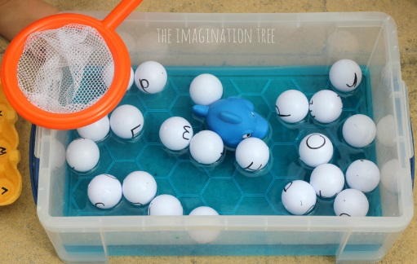


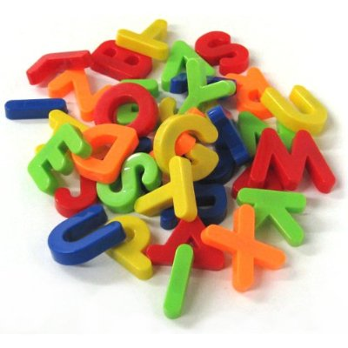



What can you do to help?
Using objects to go to correct sound around the room.
Use chalk outside
Fishing for sounds
Using phonics flash cards
Sorting objects by their sound
Playing with magnetic letters
Reading
Lists of words with the same phonemes, digraphs or trigraphs.
Play I spy

Slide 23
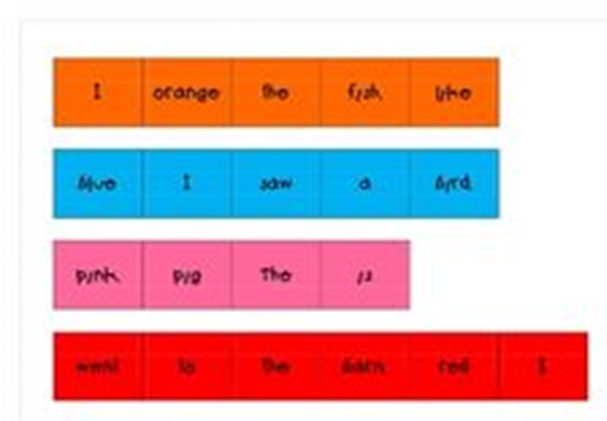
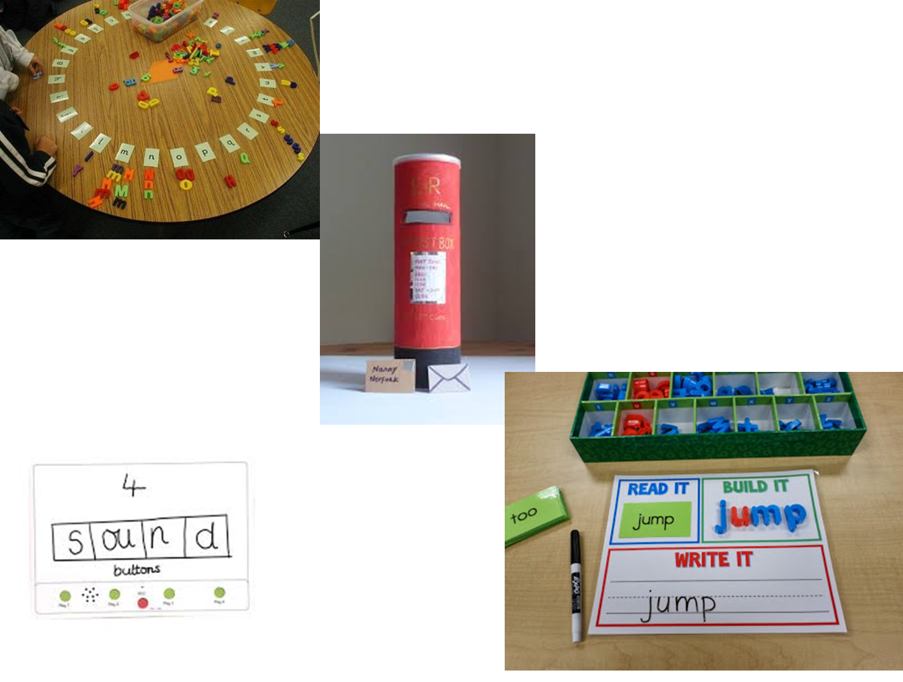
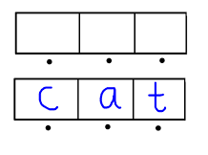
Ordering cut up sentences
Phoneme frames using counters for each sound.
Writing and making words.

Slide 24
Useful websites
https://www.bbc.co.uk/cbeebies/games​
​
https://www.phonicsplay.co.uk​
​
https://www.busythings.co.uk/​
https://home.oxfordowl.co.uk/reading/free-ebooks/
https://www.phonicsbloom.com/
https://www.topmarks.co.uk/english-games/5-7-years/letters-and-sounds
https://parents.fft.org.uk/

Slide 25
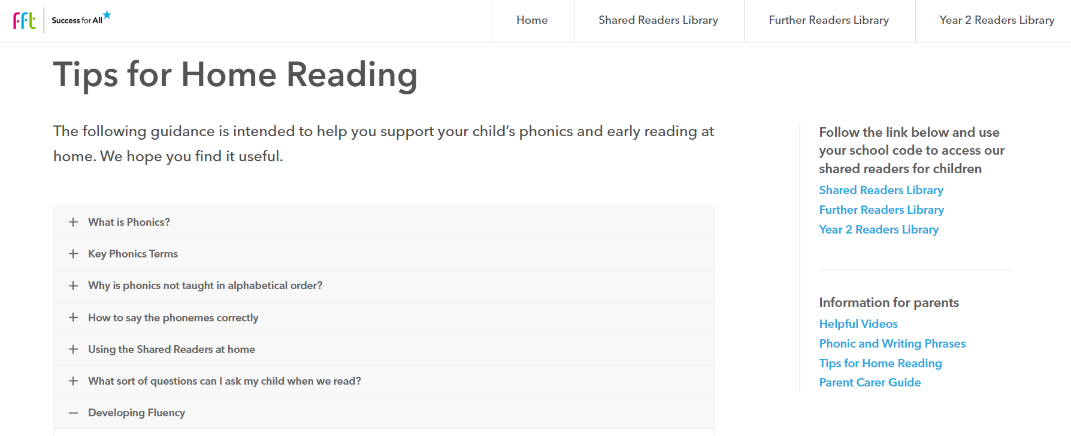
Notes:
Along with the shared reading books the parent portal has some additional information to support children at home.

Slide 26

Thank you for your time and support.

